Slide 1
Politics in the UK

Slide 2
熟肉】政治也可以很有趣——英国政治是如何运行的？究竟谁才是英国真正的主人？ 5M good
https://www.bilibili.com/video/av23285118?from=search&seid=17932980812932205976
Who is in charge of the UK?

Slide 3
Who is in charge of the UK?
In an official sense,
the queen
In a technical sense,
the Prime Minister
In a practical sense,
the members of parliament
In an idealistic sense,
us

Slide 4
Monarchy
Monarchy n.君主政体;君主国;君主政治
Monarch n.君主，帝王;最高统治者
The United Kingdom is a unitary统一的 state under a constitutional monarchy.
君主立宪制的统一国家。

Slide 5
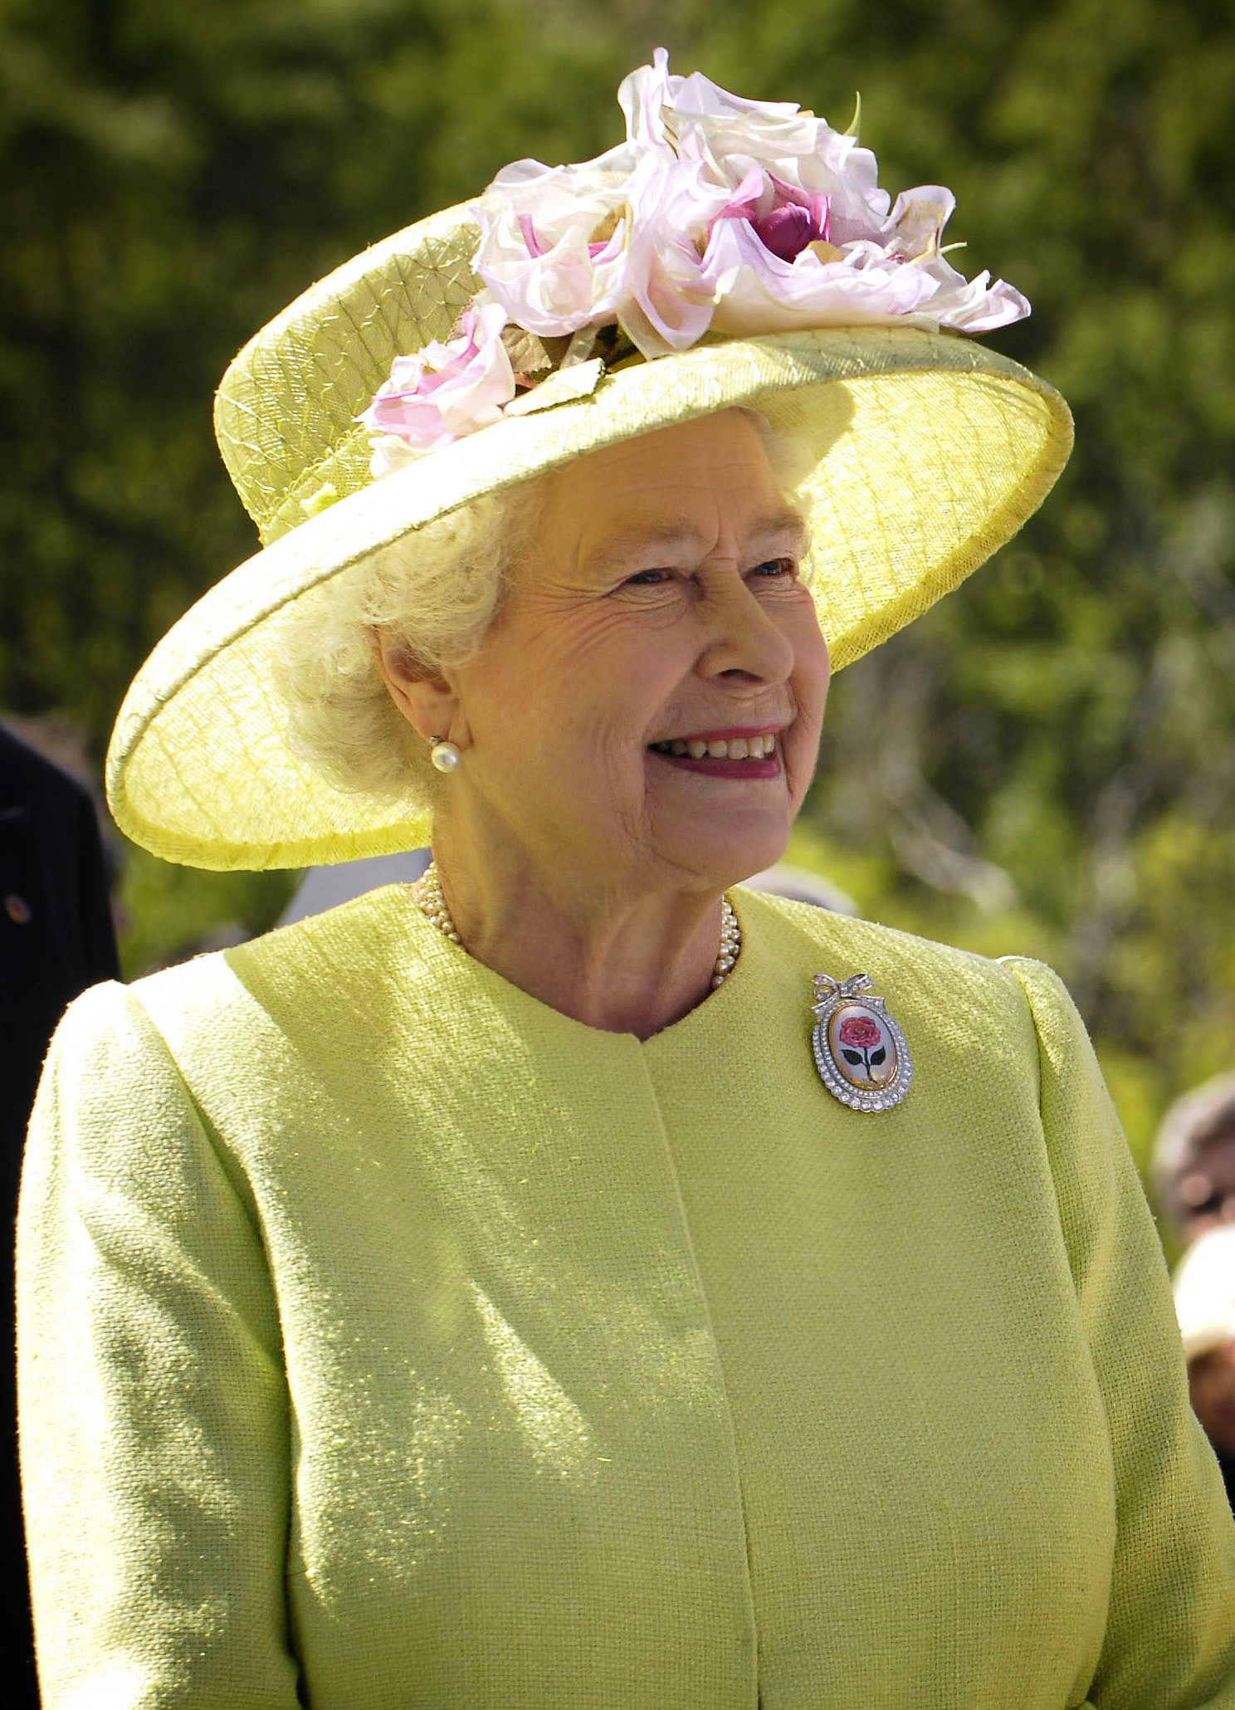
constitutional monarch
Queen Elizabeth II is the head of state of the UK as well as of fifteen other independent Commonwealth countries(英联邦国家).

Slide 6
Queen Elizabeth II is a “constitutional monarch”. This means that although she is officially the head of the state, the country is actually run by the government, led by the Prime Minister.
has no power over the nations in which she is not head of state and does not exercise power in her own realms on her own initiative.
Other figureheads include the Emperor of Japan and the King of Sweden

Slide 7
英国篇 (5)：英国皇室 good
https://www.bilibili.com/video/av9196387/?spm_id_from=333.788.videocard.33
【中英双字】趣味科普——如何才能成为英国君主？ 双字 4M good
https://www.bilibili.com/video/av24112768/?spm_id_from=333.788.videocard.27
英国女王2017年圣诞演讲【中英双字】
https://www.bilibili.com/video/av17631065/?spm_id_from=333.788.videocard.2
1957年英国女王圣诞讲话
https://www.bilibili.com/video/av4165821/?spm_id_from=333.788.videocard.39
英国皇家简史 中字 8M
每个国王的介绍，太缛长，枯燥
https://www.bilibili.com/video/av11823957/?spm_id_from=333.788.videocard.12

Slide 8
The functions:
In law, she is head of the executive行政首领,
an integral part of the legislation,
head of the judiciary司法首领,
the commander-in-chief of all the armed forces
and the “supreme governor” of the established Church of England.
ceremonial
symbolic rather than political
Queen is the figure-head空招牌，傀儡
"the right to be consulted, the right to encourage, and the right to warn".
The sovereign君主 reigns, but does not rule.

Slide 9
Queen’s husband gets the titles of “the Duke of Edinburgh” and “the Prince of the United Kingdom”.
Her eldest son gets the title “the Prince of Wales”.

Slide 10
The functions:
In law, she is head of state,
head of the executive
an integral part of the legislation,
head of the judiciary,
the commander-in-chief of all the armed forces
and the “supreme governor” of the Church of England.
represent the nation
visits
Queen’s official birthday is celebrated in June as National Day.
In practice, Queen is the figure-head: it seems that she has no real power. The sovereign reigns, but does not rule.
Queen’s husband gets the titles of “the Duke of Edinburgh” and “the Prince of the United Kingdom”. Her eldest son gets the title “the Prince of Wales”.

Slide 11
significance
undertakes constitutional and representational duties
a less formal role as 'Head of Nation”
Acts as a focus for national identity, unity and pride
gives a sense of stability and continuity
officially recognizes success and excellence
supports the ideal of voluntary service.

Slide 12
讲义
Monarchy is the oldest form of government in the United Kingdom.
In a monarchy, a king or queen is Head of State. The British Monarchy is known as a constitutional monarchy. This means that, while The Sovereign is Head of State, the ability to make and pass legislation resides with an elected Parliament.
Although The Sovereign no longer has a political or executive role, he or she continues to play an important part in the life of the nation.
As Head of State, The Monarch undertakes constitutional and representational duties which have developed over one thousand years of history. In addition to these State duties, The Monarch has a less formal role as 'Head of Nation'. The Sovereign acts as a focus for national identity, unity and pride; gives a sense of stability and continuity; officially recognises success and excellence; and supports the ideal of voluntary service.
In all these roles The Sovereign is supported by members of their immediate family.
http://www.projectbritain.com/royal/role.htm

Slide 13
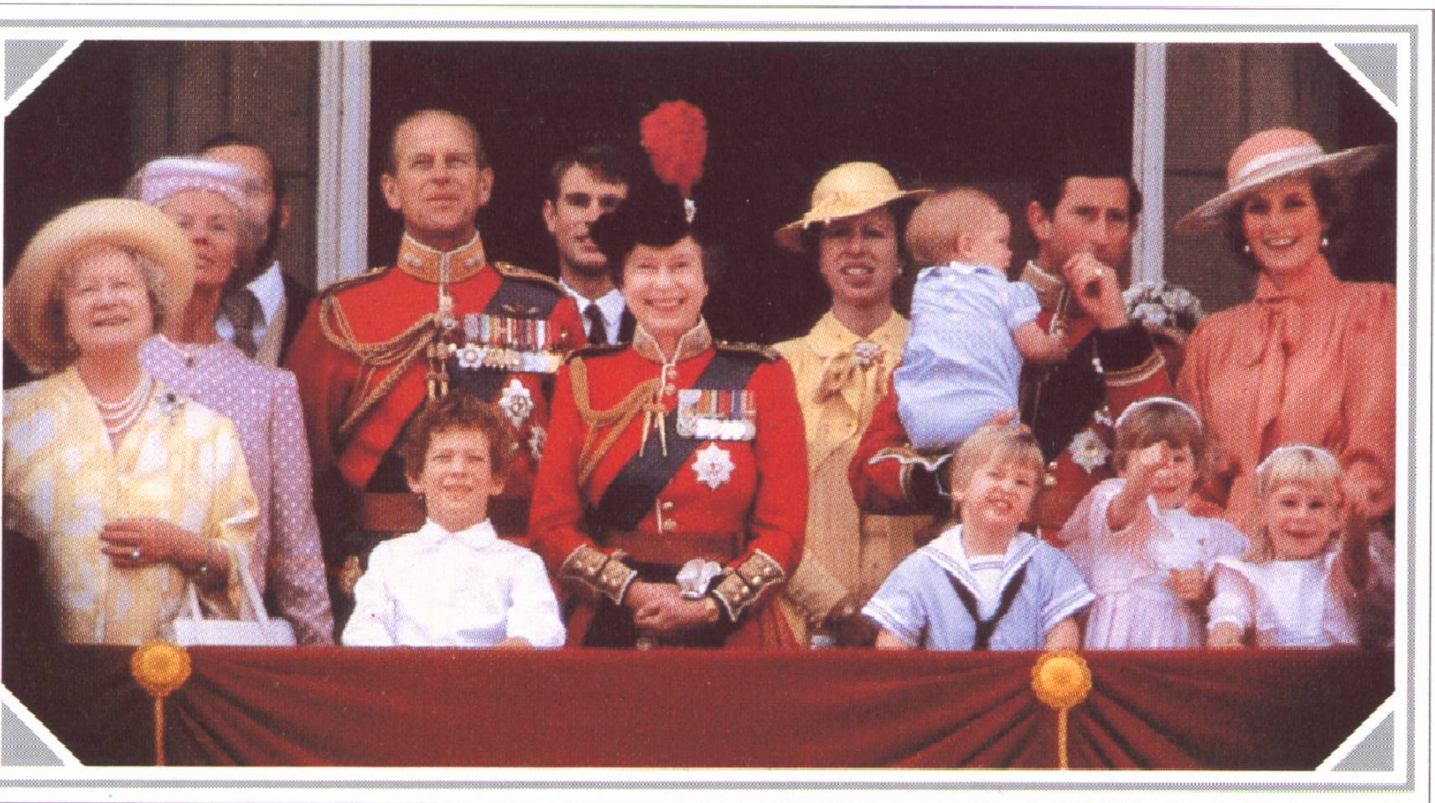
Members of the Royal Family on the bacony of Buckingham Palace to watch the fly-past, following the Queen’s Birthday Parade, 1985. The ceremony, known as Trooping the Colour, takes place on the occasion of Her Majesty’s official birthday in Jnne each year. The Queen Mother, the Duchess of Kent; Prince Michael of Kent; the Duch of Edinburgh; Prince Edward; the Queen; Princess of Anne; the Prince of Wales with the baby Prince Harry and the Princess of Wales; Children: Lord Erederick Windsor; Prince William: Lady Diana Windsor; and Lady Rose Windsor

Slide 14
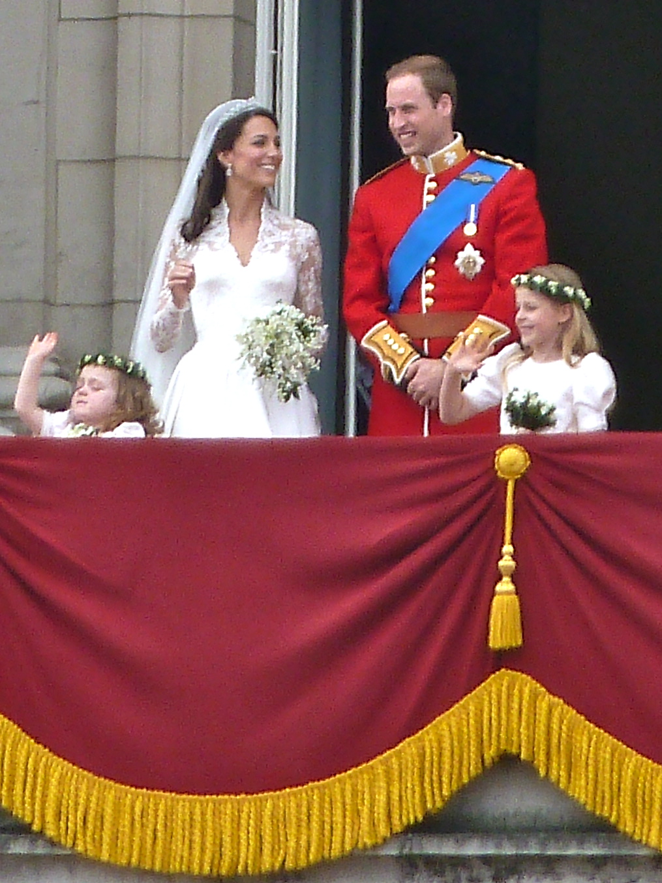
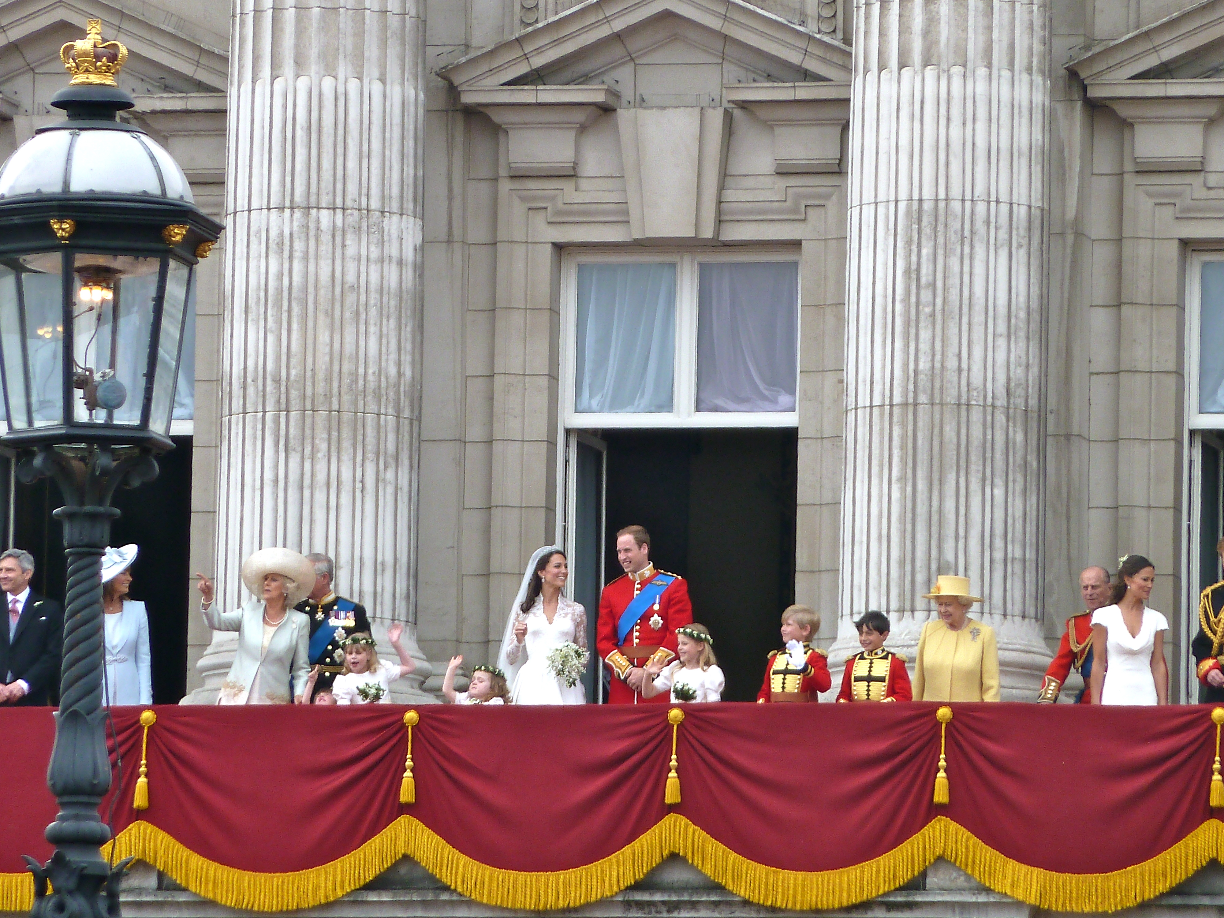
The wedding of Prince William, Duke of Cambridge, and Catherine Middleton took place on Friday, 29 April 2011 at Westminster Abbey in London. Prince William, second in the line of succession to Queen Elizabeth II, first met Catherine Middleton in 2001, whilst both were studying at the University of St Andrews. contrasted in many ways with the 1981 marriage of William's parents, Prince Charles and Lady Diana Spencer.

Slide 15
Politics of the United kingdom
constitutional monarchy

Slide 16
Politics of the United kingdom
The politics of the United Kingdom of Great Britain and Northern Ireland takes place in the framework of a constitutional monarchy, in which the Monarch is head of state and the Prime Minister of the United Kingdom is the head of government. Executive power is exercised by the UK government, the devolved governments (行政院 ) of Scotland and Wales, and the Executive of Northern Ireland. Legislative power is vested in both the government and the two chambers of Parliament, the House of Commons and the House of Lords, as well as in the Scottish parliament and Welsh and Northern Ireland assemblies. The judiciary is independent of the executive and the legislature, though several senior judges are still members of the House of Lords. In October 2009 the judicial role of the House of Lords was removed and given to a new Supreme Court under the Constitutional Reform Act 2005.

Slide 17
Political System The Principle of Separation of Powers The division of constitutional government in a democracy between three separate, independent branches: legislative, executive and judiciary.
Monarchy
legislature Parliament the Commons
the Lords
Government executive the Prime Minister and Ministries
judiciary Supreme Court

Slide 18
英国政治机构介绍 英文解说 无字幕 短视频
【英国议会动画科普】_标清 8M best
https://www.bilibili.com/video/av7099404/?spm_id_from=333.788.videocard.11

Slide 19
Summary of the Video clip
What is the heart of the UK democracy？
Parliament
The functions are
debating big issues
making and shaping laws
holding government to account
让政府负责
To examine government Policy and administrations, including proposal for expenditure

Slide 20
What is to hold the government to account
To examine government Policy and administrations, including proposal for expenditure;
检查政府政策和行政管理，包括拨款提议

Slide 21
Parliament
the Sovereign:summoning, dissolving and proroguing 召唤，解散，拖延
the Commons(646): general election and by-election
Parliament
Lords temporal : hereditary and life peers(628+92)
the Lords Lords spiritual:Archbishops and bishops(26)
世俗议员
世袭
神职议员
大主教

Slide 22
讲义
The parliament is bicameral有两个议会的, with an upper house, the House of Lords, and a lower house, the House of Commons. The Queen is the third component of the legislature. The House of Lords includes two different types of members: the Lords Spiritual (the senior bishops of the Church of England) and the Lords Temporal (members of the Peerage) whose members are not elected by the population at large, but are appointed by the Sovereign on advice of the Prime Minister. Prior to the opening of the Supreme Court in October 2009 the House of Lords also performed a judicial role through the Law Lords.

Slide 23
the House of Commons
The Countries of the United Kingdom are divided into parliamentary constituencies选区 of broadly equal population. Each constituency elects a Member of Parliament (MP) to the House of Commons at General Elections. MPs in the House of Commons may remain MPs until Parliament is dissolved, which must occur within 5 years of the last general election, as stated in the Parliament Act 1911.

Slide 24
The commons is the most important place for discussing policies and making laws.
In modern times, all Prime Ministers and Leaders of the Opposition have been drawn from the Commons, not the Lords. The House of Commons is the source of real political power in the United Kingdom. Its members are democratically elected by citizens over the age of 18. Certain groups that are denied the right to vote, including members of the House of Lords, and those convicted of corrupt or illegal election practices in the previous five years.

Slide 25
【英字】探秘英国下议院 英字 20M
https://www.bilibili.com/video/av6211687?from=search&seid=11238772552646613532
MP
constituent 选民
Chamber 议事厅
Amendment， bill
Gallery(大厅的)楼座，楼上旁听席
petition 请愿书， 请愿
adjournment debate休会辩论
opposition
Shadow cabinet：The Official Opposition Shadow Cabinet
back bencher

Slide 26
In Westminster parliamentary systems, a backbencher is a Member of Parliament (MP) or a legislator who holds no governmental office and is not a frontbenchspokesperson in the Opposition, being instead simply a member of the "rank and file" 普通议员

Slide 27
Questions?
Who sits in the house of commons?
How do they become the members of the house of commons?
What are the functions of the house of commons?
Discussing policies and making laws

Slide 28
The Parliament of the United Kingdom of Great Britain and Northern Ireland is the supreme legislative body in the United Kingdom, British Crown dependencies and British overseas territories. It is located in Westminster, London. Parliament alone possesses legislative supremacy and thereby ultimate power over all other political bodies in the UK and its territories. At its head is the Sovereign, Queen Elizabeth II.

Slide 29
讲义
The House of Commons is a democratically elected chamber with elections to it held at least every five years. The two Houses meet in separate chambers in the Palace of Westminster (commonly known as the Houses of Parliament), in London. By constitutional convention, all government ministers, including the Prime Minister, are members of the House of Commons or, less often, the House of Lords, and are thereby accountable to the respective branches of the legislature.

Slide 30
The House of Lords
Unlike the elected House of Commons, most new members of the House of Lords are appointed. Membership of the House of Lords is made up of Lords Spiritual and Lords Temporal. There are currently 26 Lords Spiritual who sit in the Lords by virtue of their ecclesiastical 教会的role in the established Church of England. The Lords Temporal make up the rest of the membership; of these, the majority are life peers who are appointed by the Monarch on the advice of the Prime Minister, or on the advice of the House of Lords Appointments Commission.

Slide 31
Membership was once a right of birth to hereditary世袭的 peers贵族 but, following a series of reforms, only 92 members (as of 1 July 2011 [update]) sitting by virtue of a hereditary peerage remain. The number of members is not fixed; as of 11 June 2012 the House of Lords has 775 members (not including 28 who are on leave of absence or are otherwise disqualified from sitting), unlike the House of Commons, which has a 650-seat fixed membership

Slide 32
The functions: The House of Lords is independent from, and complements the work of, the House of Commons;
the Lords share responsibility for making laws and checking government action.
Bills can be introduced into either the House of Lords or the House of Commons and members of the Lords may also take on roles as Government Ministers.

Slide 33
英字】探秘英国上议院 英字 5M
https://www.bilibili.com/video/av6212462/?spm_id_from=333.788.videocard.37
Peer
chamber 议事厅
opposition（政府的）反对党，在野党
Bishop（基督教某些教派管辖大教区的） 主教
Clerk议会的书记员
lobby大厅
corridor走廊
legislation立法，制定法律;法律，法规
scrutinize仔细检查

Slide 34
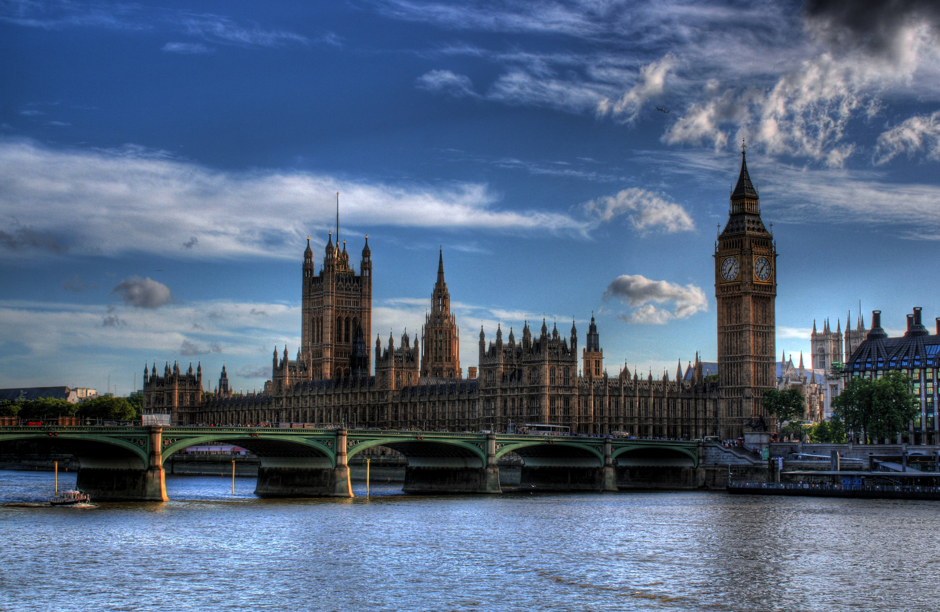
The Palace of Westminster, seat of both houses of the Parliament of the United Kingdom

Slide 35
Edward the Confessor made the Palace of Westminster the first official London residence. It is now the seat of British democracy. It is where the UK government is.
built in the mid-19th century.
The Palace contains over 1,000 rooms,
Has over 1,000 rooms, 100 staircases, 11 courtyards, eight bars and six restaurants, two miles of corridors - none of them open to the public.
the most important of which are the Chambers of the House of Lords and of the House of Commons.

Slide 36
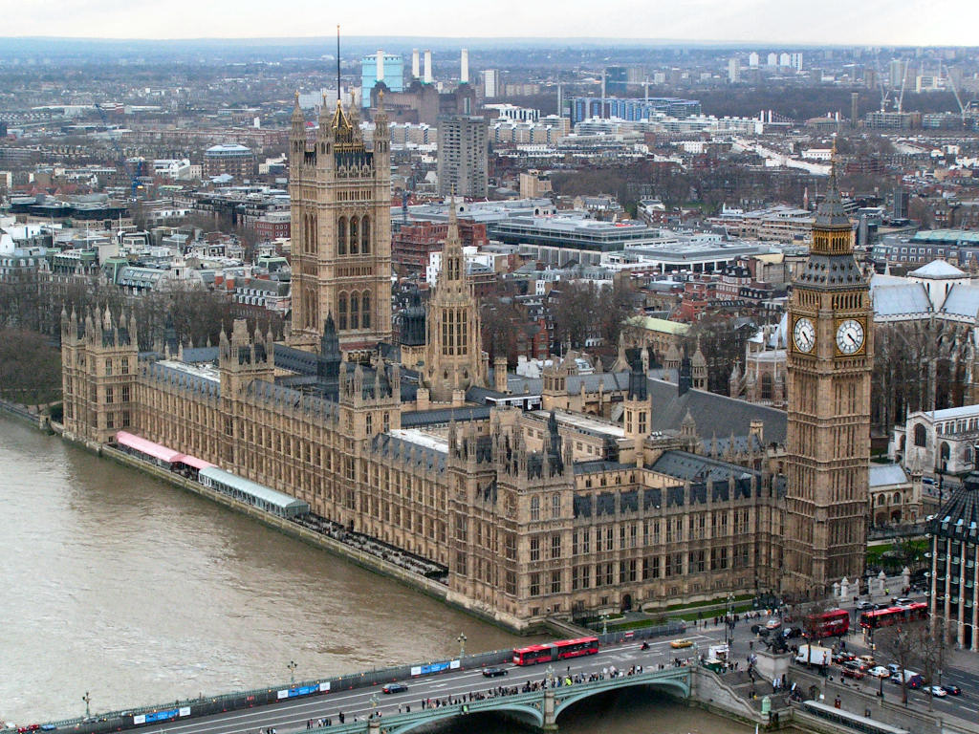
over 1,000 rooms,
100 staircases,
11 courtyards,
eight bars,
six restaurants,
two miles of corridors
The Palace of Westminster, here viewed from the London Eye, sits on the north bank of the River Thames, near Westminster Bridge. Its principal towers are, from left to right, the Victoria Tower, the Central Tower and the Clock Tower, also known as "Big Ben".

Slide 37
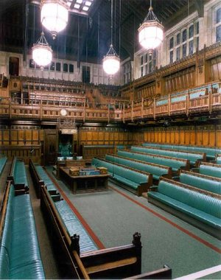
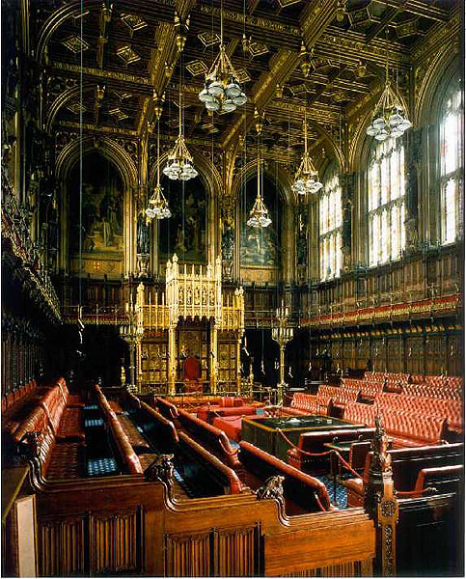

Slide 38
Legislature
the Sovereign:summoning, dissolving and proroguing 召唤，解散，拖延
the Commons(650): general election and by-election
Parliament
Lords temporal : hereditary and life peers(628+92)
the Lords Lords spiritual:Archbishops and bishops(26)
Review

Slide 39
Executive: Government of the United Kingdom
the Prime Minister,
The Government is led by
who is appointed by
He or she is the leader of the party that holds the most seats in
the Queen
the House of Commons.

Slide 40
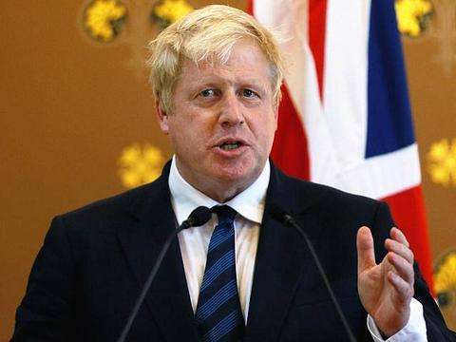
Boris Johnson鲍里斯·约翰逊

Slide 41
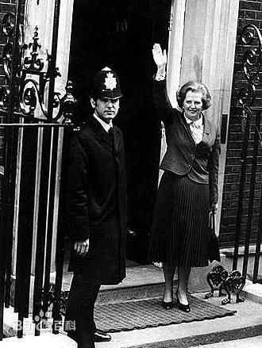
Madame Thatcher

Slide 42
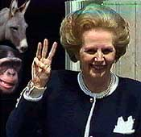
Margaret Thatcher
Served (1979 - 1990) longer without interruption than any other British prime minister in 20th century

Slide 43
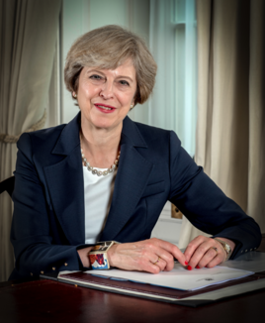
Theresa Mary May
(2016-2019)[tiˈri:zə]
特雷莎·玛丽·梅（Theresa Mary May，简称“特雷莎·梅”、“特蕾莎·梅”或“特里莎·梅”、“特丽莎·梅”，港译“文翠珊”），1956年10月1日生于英国伊特斯，本人毕业于牛津大学地理专业。英国保守党籍女性政治家，曾任第76任英国首相及保守党领袖，是英国历史上第二位女首相。
大学毕业后曾在银行界工作，1986年当选伦敦市议员步入政界，1997年当选为英国国会议员，2002至2003年曾担任保守党主席，2010年保守党大选获胜后出任内政大臣。 [1] 卡梅伦辞职后，特蕾莎·梅顺利地成为了党首和首相的继任者。
2016年7月11日，当选为英国第54任首相，同时是英国历史上第二位女首相。2016年9月22日，彭博全球50大最具影响力人物排行榜，特蕾莎·梅排第一名。 [2]

Slide 44
PMQ
Every Wednesday the Prime Minister appears before the House of Commons and must answer questions put to him or her by the members of Parliament.
英国议会下院_首相问答PMQs_20170419 interesting 12M
https://www.bilibili.com/video/av10012974/?spm_id_from=333.788.videocard.17
（已翻译）英国下议院的噪音都是什么鬼 3M good 介绍P&Q规则及噪音
https://www.bilibili.com/video/av23187602/?spm_id_from=333.788.videocard.17
中字】史上最萌国会议长 [英国国会特辑Part2]@阿尔法小分队科教组 3M good & interesting
https://www.bilibili.com/video/av5149627/?spm_id_from=333.788.videocard.1
【中英双语字幕】被议长大人害惨了的英国白金汉人民... 介绍议长 3M good
https://www.bilibili.com/video/av32580768/?spm_id_from=333.788.videocard.7

Slide 45
Parliament
the Sovereign:summoning, dissolving and proroguing 召唤，解散，拖延
the Commons(650): general election and by-election
Parliament
Lords temporal : hereditary and life peers(628+92)
the Lords Lords spiritual:Archbishops and bishops(26)
Review

Slide 46
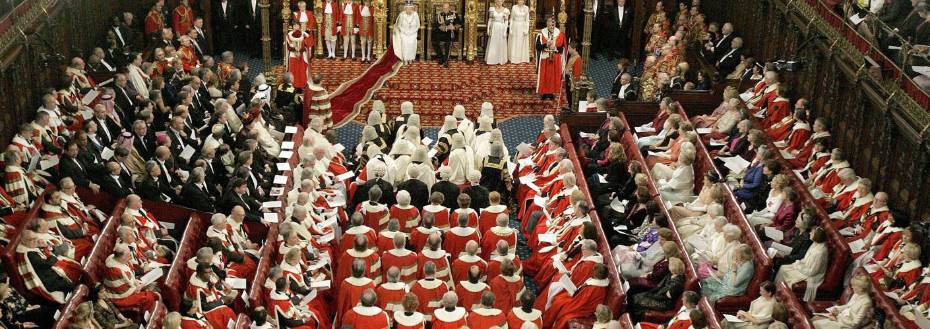
State Opening of Parliament
英国国会开幕大典

Slide 47
State Opening of Parliament
英国国会开幕大典
marks the formal start of the parliamentary year
the Queen's Speech sets out the government’s agenda for the coming session,
outlining proposed policies and legislation.

Slide 48
State Opening of Parliament
英国国会开幕大典
the main ceremonial event of the parliamentary calendar
marks the formal start of the parliamentary year
the Queen's Speech sets out the government’s agenda for the coming session, outlining proposed policies and legislation.

Slide 49
State Opening of Parliament英国国会开幕大典
满眼都是礼仪！91岁的英国女王主持议会开幕大典 今年走的还是简约风……
https://www.bilibili.com/video/av11526931/?spm_id_from=333.788.videocard.4

Slide 50
an elaborate ceremony

Slide 51
The State Opening of Parliament marks the formal start of the parliamentary year and the Queen's Speech sets out the government’s agenda for the coming session, outlining proposed policies and legislation. It is the only regular occasion when the three constituent parts of Parliament – the Sovereign, the House of Lords and the House of Commons – meet.
The State Opening is an elaborate ceremony showcasing British history, culture and contemporary politics to large crowds and television viewers.

Slide 52
When is State Opening?
State Opening happens on the first day of a new parliamentary session or shortly after a general election. t takes place in the House of Lords chamber, usually in May or June, but traditionally in November, in front of both Houses of Parliament.
What happens during State Opening
State Opening is the main ceremonial event of the parliamentary calendar, attracting large crowds and a significant television and online audience. It begins with the Queen's procession from Buckingham Palace to Westminster, escorted by the Household Cavalry.
The Queen arrives at Sovereign's Entrance and proceeds to the Robing Room. Wearing the Imperial State Crown and the Robe of State, she leads the Royal Procession through the Royal Gallery, packed with 600 guests, to the chamber of the House of Lords.
The House of Lords official known as 'Black Rod' is sent to summon the Commons. The doors to the Commons chamber are shut in his or her face: a practice dating back to the Civil War, symbolising the Commons' independence from the monarchy. Black Rod strikes the door three times before it is opened. Members of the House of Commons then follow Black Rod and the Commons Speaker to the Lords chamber, standing at the opposite end to the Throne, known as the Bar of the House, to listen to the speech.
The Queen's Speech
The Queen's Speech is delivered by the Queen from the Throne in the House of Lords. Although the Queen reads the Speech, it is written by the government. It contains an outline of its policies and proposed legislation for the new parliamentary session.

Slide 53
After the Queen's Speech
When the Queen leaves, a new parliamentary session starts and Parliament gets back to work. Members of both Houses debate the content of the speech and agree an ‘Address in Reply to Her Majesty’s Gracious Speech’. Each House continues the debate over the planned legislative programme for several days, looking at different subject areas. The Queen's Speech is voted on by the Commons, but rarely in the Lords.
History of State Opening
Traditions surrounding State Opening and the delivery of a speech by the monarch can be traced back as far as the 16th century. The current ceremony dates from the opening of the rebuilt Palace of Westminster in 1852 after the fire of 1834.
significance
The State Opening of Parliament is a ceremony loaded with historical ritual and symbolic significance for the governance of the United Kingdom. In one place are assembled the members of all three branches of government, of which the Monarch is the authority and nominal head in each part: the Crown-in-Parliament, (the Queen, together with the House of Commons and the House of Lords), constitutes the legislature; the Queen-in-Council, Her Majesty's Ministers (who are members of one or other House, and members of Her Majesty's Privy Council) constitute the executive; the Queen-on-the-Bench, consisting of Her Majesty's Judges, although not members of either House, are summoned to attend and represent the judiciary. Therefore, the State Opening demonstrates the governance of the United Kingdom but also the separation of powers.

Slide 54
The Prime Minister and Cabinet (consisting of all the most senior government department heads) are collectively accountable for their policies and actions to the Sovereign, to Parliament, to their political party, and ultimately to the electorate.
In practice, the Prime Minister selects the other members of the Government and their appointment is confirmed by the Queen. The Government is fused with(接合) Parliament, which means that in practice a government must seek re-election at least every five years.

Slide 55
讲义
The Prime Minister is based at 10 Downing Street, which has been official residence of British Prime Minister since 1732. along with most government departments, is located in Westminster.
Congress, Treasury and Foreign Affairs are only a few minutes away from No. 10 Downing Street, so the Prime Minister can easily get information and contacts. In addition, Buckingham Palace, where the monarch lives, is nearby so that the Prime Minister can visit Buckingham Palace regularly to report to the monarch.

Slide 56
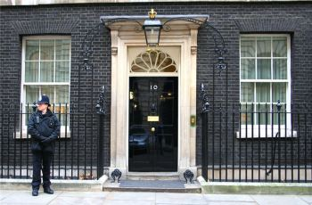
3 Symbols of British politics
1732

Slide 57
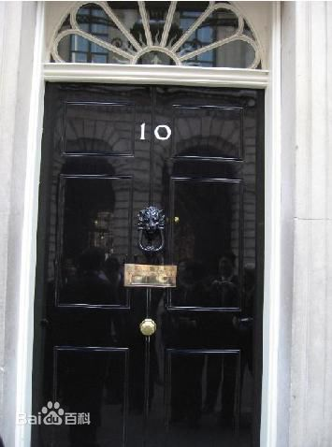
The principal Government department
the Treasury,
the House of office,
the Foreign and Commonwealth office,
the Ministry of Defense
财务部，内务部，外交部，国防部

Slide 58
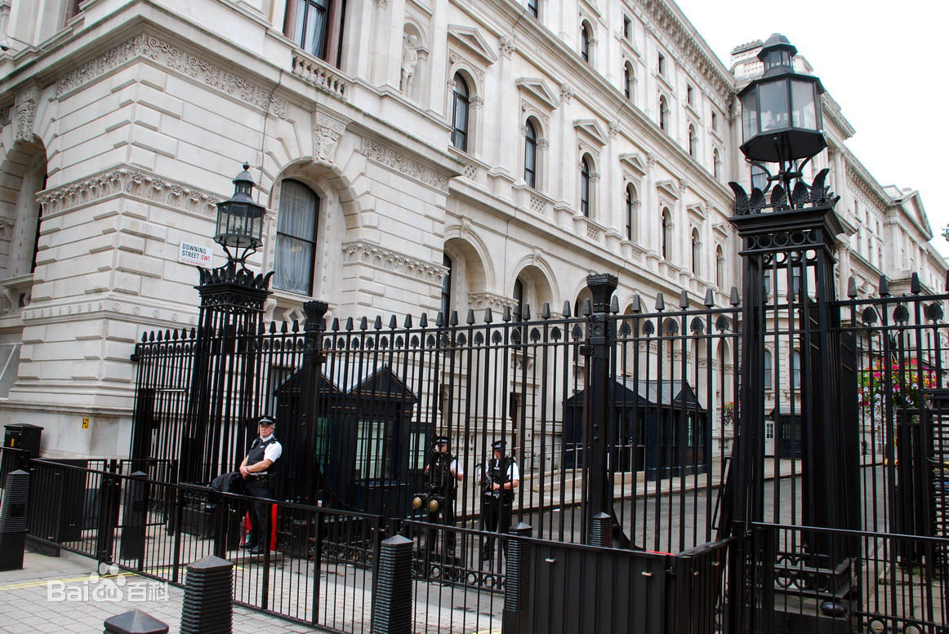

Slide 59
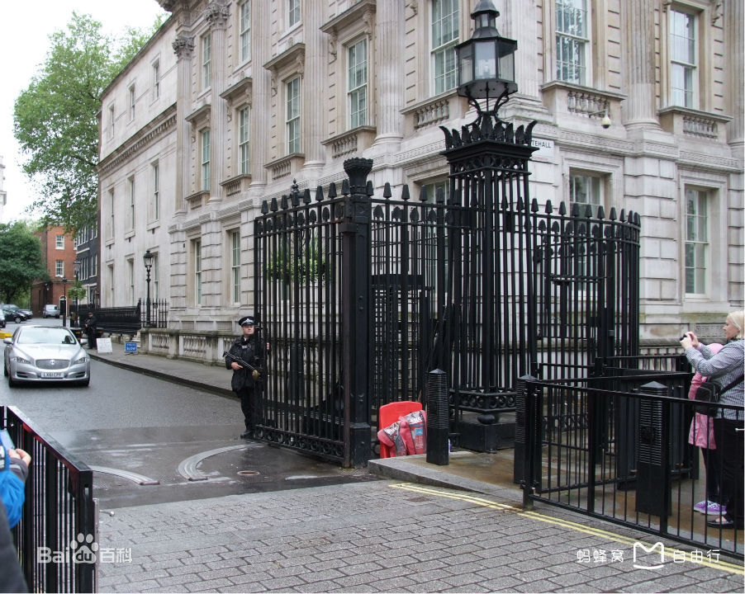

Slide 60
The 2nd symbol of British politics

Slide 61
Palace of Westminster

Slide 62
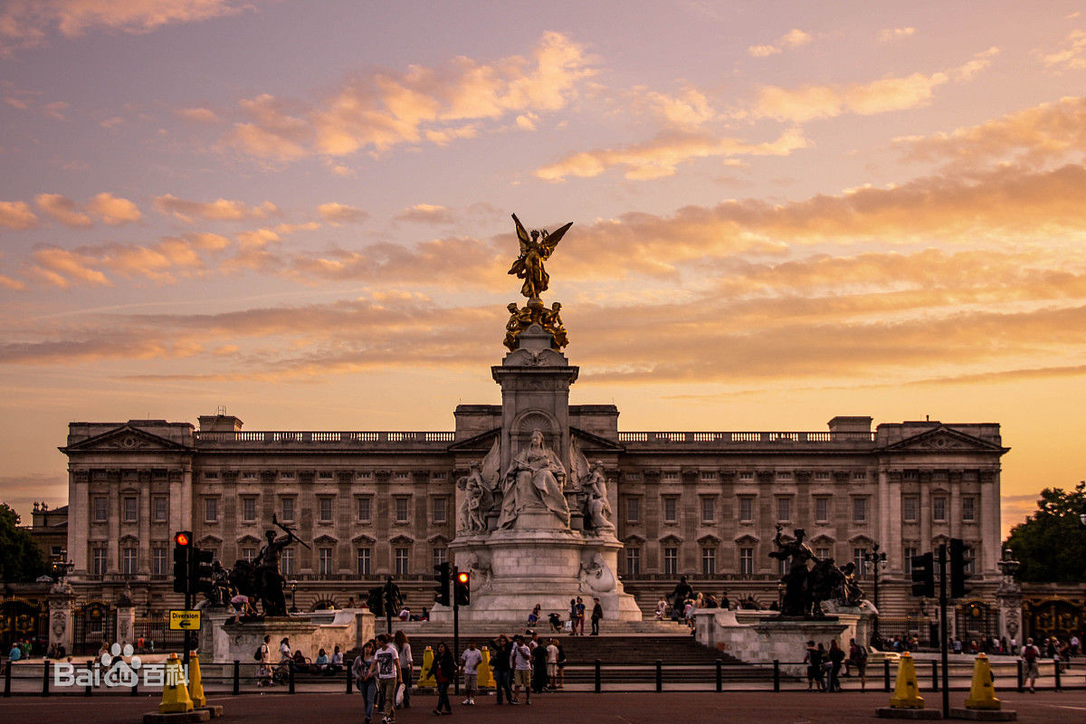
3rd symbol:
Palace Of Buckingham

Slide 63
Judiciary in Britain
The judicial branch of the British government is rather complicated in that England and Wales ,Scotland and Northern Ireland all have their own legal systems, with minor differences in law, organization and practice.
The judicial system is disunity
why?
The United Kingdom does not have a single legal system due to it being created by the political union of previously independent countries.
the United Kingdom of Great Britain and Northern Island

Slide 64
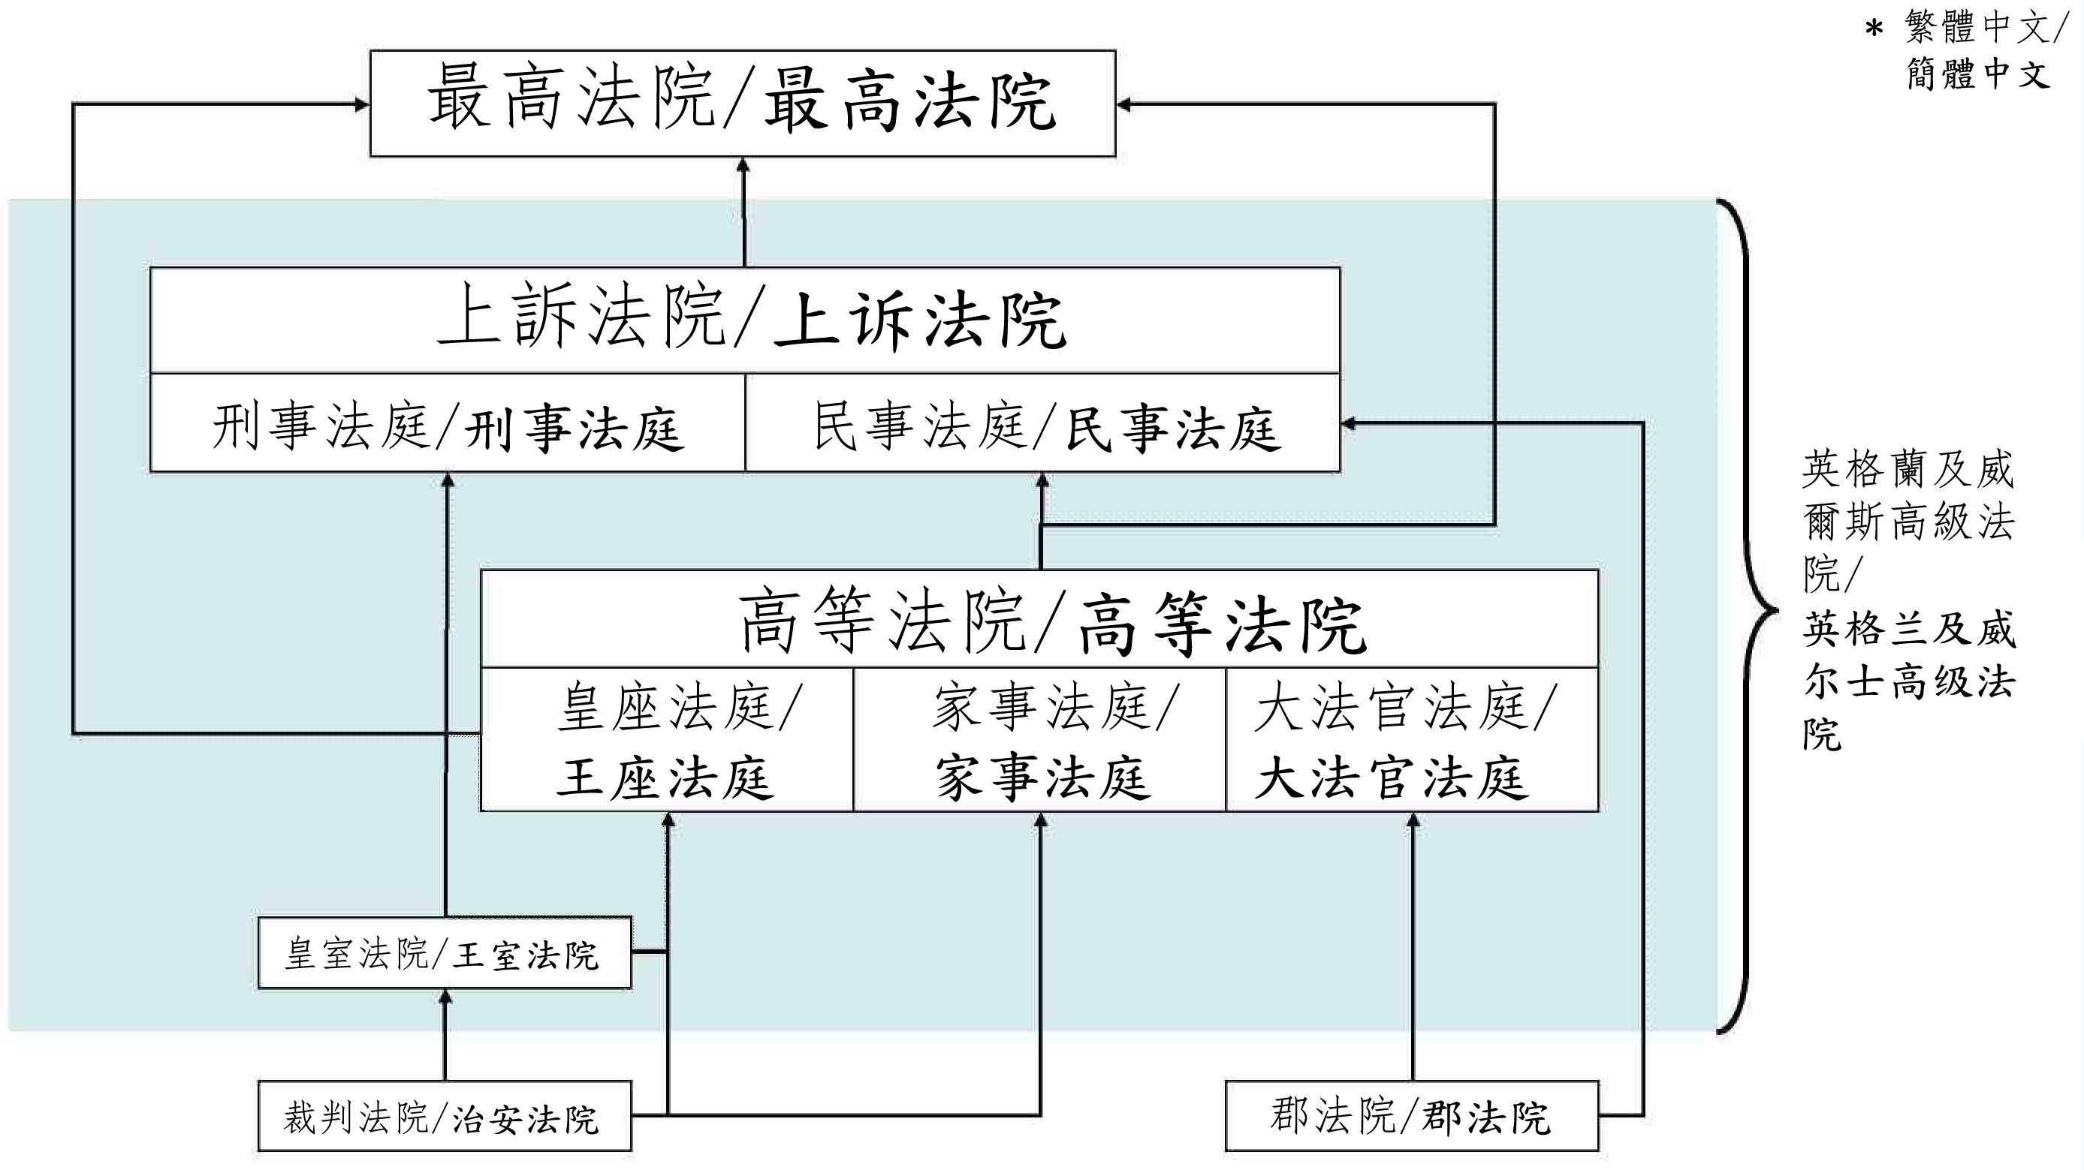

Slide 65
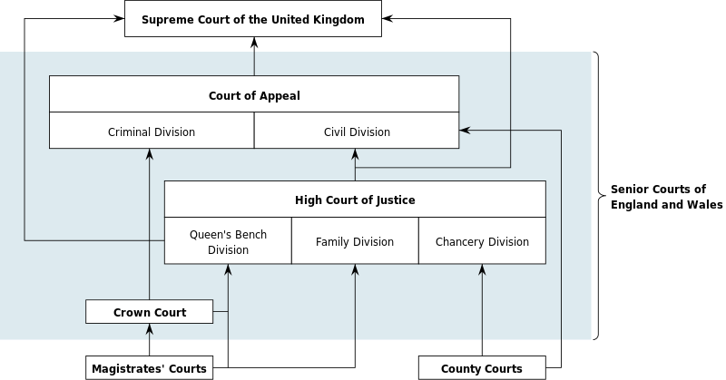
Schematic of court system for England and Wales

Slide 66
Different types of cases are dealt with in specific courts.
Criminal cases: the magistrates’ court（地方法院）
The Crown Court(刑事法庭)
The High Court(高等法庭)
The Court of Appeal （上诉法院）
The Supreme Court(最高法院)
Civil cases :be dealt with by magistrates
A county court(郡法院)
The High Court
The Court of Appeal

Slide 67
the Law
Today the UK has three distinct systems of law: English law, Northern Ireland law and Scots law.
English law, which applies in England and Wales,
and Northern Ireland law, which applies in Northern Ireland, are based on common-law principles.
Scots law, which applies in Scotland, is a pluralistic system based on civil-law principles, with common law elements dating back to the High Middle Ages.

Slide 68
the Law: British Constitution
Britain does not have a single document that can be called the written constitution.
Composition of the British constitution:
statutes, judge-made case law and international treaties, together with constitutional conventions.
成文法、法官制定的判例法和国际条约，以及宪法公约

Slide 69
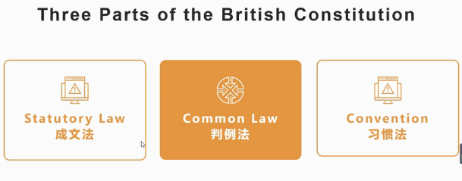
https://www.bilibili.com/video/BV1Ua4y1x7ea?from=search&seid=15076409229081176840

Slide 70
The United Kingdom has an uncodified constitution. The Constitution of the United Kingdom thus consists mostly of a collection of disparate written sources, including statutes, judge-made case law and international treaties, together with constitutional conventions.
联合王国有一部未经编纂的宪法。因此，联合王国的宪法主要由一系列不同的书面资料组成，包括成文法、法官制定的判例法和国际条约，以及宪法公约。

Slide 71
The United Kingdom does not have a single unified legal system —England and Wales have one system, Scotland another, and Northern Ireland a third. There are exceptions to this rule; for example in immigration law, the Asylum and Immigration Tribunal's jurisdiction covers the whole of the United Kingdom, while in employment law there is a single system of Employment Tribunals for England, Wales, and Scotland (but not Northern Ireland). Additionally, the Military Court Service has jurisdiction over all members of the armed forces of the United Kingdom in relation to offences against military law.
The Court of Appeal, the High Court, the Crown Court, the Magistrates' Courts, and the County Courts are administered by Her Majesty's Courts and Tribunals Service, an executive agency of the Ministry of Justice.

Slide 72
The Supreme Court of the United Kingdom is the supreme court in all matters under English law, Northern Irish law and Scottish civil law. It is the court of last resort and the highest appellate court in the United Kingdom, although the High Court of Justiciary remains the supreme court for criminal cases in Scotland. The Supreme Court also has jurisdiction to resolve disputes relating to devolution in the United Kingdom and concerning the legal powers of the three devolved governments (in Scotland, Wales and Northern Ireland) or laws made by the devolved legislatures. The Supreme Court was established by Part 3 of the Constitutional Reform Act 2005 and started work on 1 October 2009. It assumed the judicial functions of the House of Lords, which had been exercised by the Lords of Appeal in Ordinary (commonly called "Law Lords"), the 12 professional judges appointed as members of the House of Lords to carry out its judicial business. Its jurisdiction over devolution matters had previously been exercised by the Judicial Committee of the Privy Council.

Slide 73
summary
The judicial system is disunity /different legal system
does not have a single document that can be called the written constitution.
three distinct systems of law

Slide 74
Jury trial_x000b_The jury陪审团 is normally composed of 12 members known as jurors or jurymen.
The UK has abolished the death penalty, with life imprisonment becoming the maximum penalty

Slide 75
Summary
Political System The Principle of Separation of Powers
Monarchy
legislature Parliament the Commons
the Lords
Government executive the Prime Minister and Ministries
judiciary Supreme Court

Slide 76
Elections in the United Kingdom
There are five types of elections in the United Kingdom: United Kingdom general elections, elections to devolved parliaments and assemblies, elections to the European Parliament, local elections and mayoral elections. Elections are held on Election Day, which is conventionally a Thursday. General elections do not have fixed dates, but must be called within five years of the opening of parliament following the last election. Other elections are held on fixed dates though in the case of the devolved assemblies and parliaments, early elections can occur in certain situations. Presently, six electoral systems are used: single member plurality system (First Past the Post), multi member plurality system, Party list, Single Transferable Vote, Additional Member System and Supplementary Vote.

Slide 77
The UK is a multi-party system and since the 1920s, the two largest political parties have been
the Conservative Party and the Labour Party.

Slide 78
3. 7. Political Party System For the 160 years a predominantly two-party system has existed. The earliest political parties in the world are the Tories and the Whigs.
The Conservative Party developed out of the Tories in the 1830’. It supports free enterprise, encourages property owning and has been responsible for main important social reforms. It finds its support mainly in middle and upper class or Establishment circles, traditionally in rural areas.
The Labor Party grew up at the end of the 19th century, first taking the name Labor Party in 1906. It claims to represent the interests of the working class as against the interests of the employers. It draws most of its support from highly urban and industrialized areas, as well as being the main party for working class people,it is also supported by a significant number of middle class people, especially intellectuals.Its policies are closely connected with those of the trade union movement. The party which wins a majority of seats in the Commons wins the election and will form the Government.

Slide 79
英国大选
2017英国大选是怎么个情况？？3M 中文字幕 good 介绍政党
https://www.bilibili.com/video/av11183517/?spm_id_from=333.788.videocard.2
80秒趣味动画带你了解英国大选 双字幕 good
https://www.bilibili.com/video/av2210793/?spm_id_from=333.788.videocard.15

Slide 80
What is a general election?
The election of all Members of Parliament (MPs)
for each constituency (local area) is called a
General Election. In the US it is like voting for
a Congressman or Senator. However, unlike
the US, the voters do not choose the Prime
Minister (PM). He/she is voted for within their
party
选的是议员,如果某派在下议院占据多数，那么就获得组阁机会获得组阁权后，由其内部候选人出任首相

Slide 81
Summary

Slide 82
1. constitutional monarchy
Queen Elizabeth II is a “constitutional monarch”. This means that although she is officially the head of the state, the country is actually run by the government, led by the Prime Minister.
has no power over the nations in which she is not head of state and does not exercise power in her own realms on her own initiative.

Slide 83
Political System The Principle of Separation of Powers The division of constitutional government in a democracy between three separate, independent branches: legislative, executive and judiciary.
Monarchy
legislature Parliament the Commons
the Lords
Government executive the Prime Minister and Ministries
judiciary Supreme Court

Slide 84
What is Parliament?
Parliament is where politicians (MPs) meet to decide laws and make decisions for the United Kingdom. It is not the same as the Government (which runs the country). One of the jobs Parliament does is to check that the Government is running the country properly.
Parliament decides the laws and make decisions on running the UK. (Some issues in Scotland,Wales and Northern Ireland are now dealt with by their respective parliaments and assemblies.) There has been a parliament at Westminster since the 13th Century.

Slide 85
What is the job of Parliament?
The main functions of Parliament are:
to pass laws
to provide, by voting for taxation, the means of carrying on the work of government
to scrutinize government policy and administration, including proposals for expenditure
to debate the major issues of the day
Parliament is made up of three parts:
The Queen
The House of Lords
The House of Commons

Slide 86
The Queen
The Queen is the official Head of State. Britain has a constitutional monarchy where the Queen only rules symbolically; in reality, power belongs to Parliament. So, although the Queen 'opens' Parliament each year and laws are passed in her name, the Queen herself plays no part in determining decisions made in Parliament.
The Queen has the final say on whether a bill becomes law.
The last Monarch to reject a law that was wanted by both Houses of Parliament was Queen Anne. She died in 1715.

Slide 87
The House of Commons
Who sits in the House of Commons?
A person who sits in the House of Commons is called a Member of Parliament (MP).
The House of Commons has 650 members (MPs) who have been elected by local residents to represent an area of the country in Parliament.
Each MP represents one of 650 constituencies (areas) in the UK and is a member of a political party, such as New Labour or the Conservative party.
What happens in the House of Commons?
The Commons is the most important place for discussing policies and making laws.

Slide 88
The House of Lords
The House of Lords is made up of people who have inherited family titles and those who have been given titles because of their outstanding work in one field or another. There are 675 members of the Lords.
Who sits in the House of Lords?
A person who sits in the House of Lords is a peer
What is the job of the peers in the House of Lords?
The main job of the House of Lords is to 'double check' new laws to make sure they are fair and will work.

Slide 89
Summary of parliament
参考资料
http://www.projectbritain.com/government/index.htm

Slide 90
Summary & Review
What do you know about the politics of the UK?
Monarchy
Parliament
House of lords
House of commons
queen
Prime minister
Judiciary
General election

Slide 91
Political System The Principle of Separation of Powers The division of constitutional government in a democracy between three separate, independent branches: legislative, executive and judiciary.
Monarchy
legislature Parliament the Commons
the Lords
Government executive the Prime Minister and Ministries
judiciary Supreme Court

Slide 93
Thank You !

